Slide 1
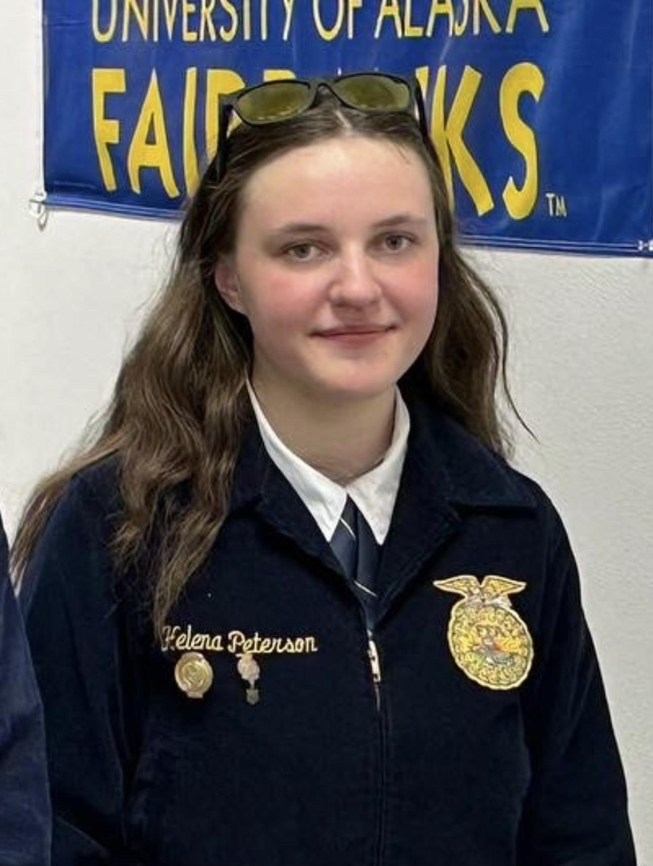
Agricultural Education Placement
Helena Peterson
State Proficiency Awards
Notes:
Helena’s SAE consists of her spending time caring for children. She has completed a first aid and CPR certification for babies and children in order to better complete her duties in enriching and helping with the growth and early education of them. Congratulations Helena.

Slide 2
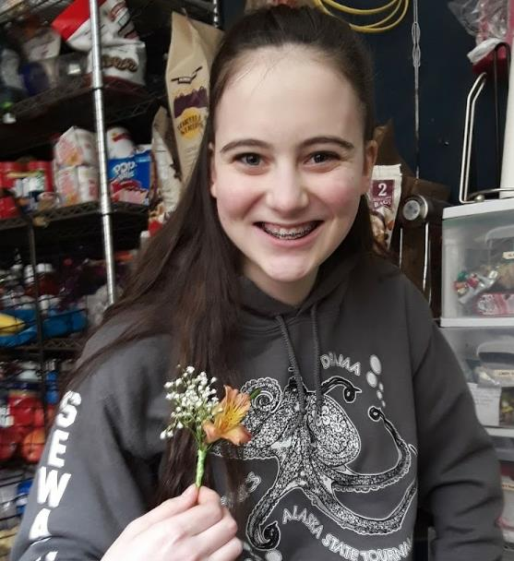
Outdoor Recreation Placement
Aly Guernsey
State Proficiency Awards
Notes:
Aly works for Tern Lake Inn, a wedding venue and outdoor area. She is in charge of the maintenance and appearance of one cabin and helps with the aesthetics and general care of multiple others. In her SAE, she has had the opportunity to create floral arrangements and develop skills to make her work more efficient. Congratulations Aly.

