Slide 1
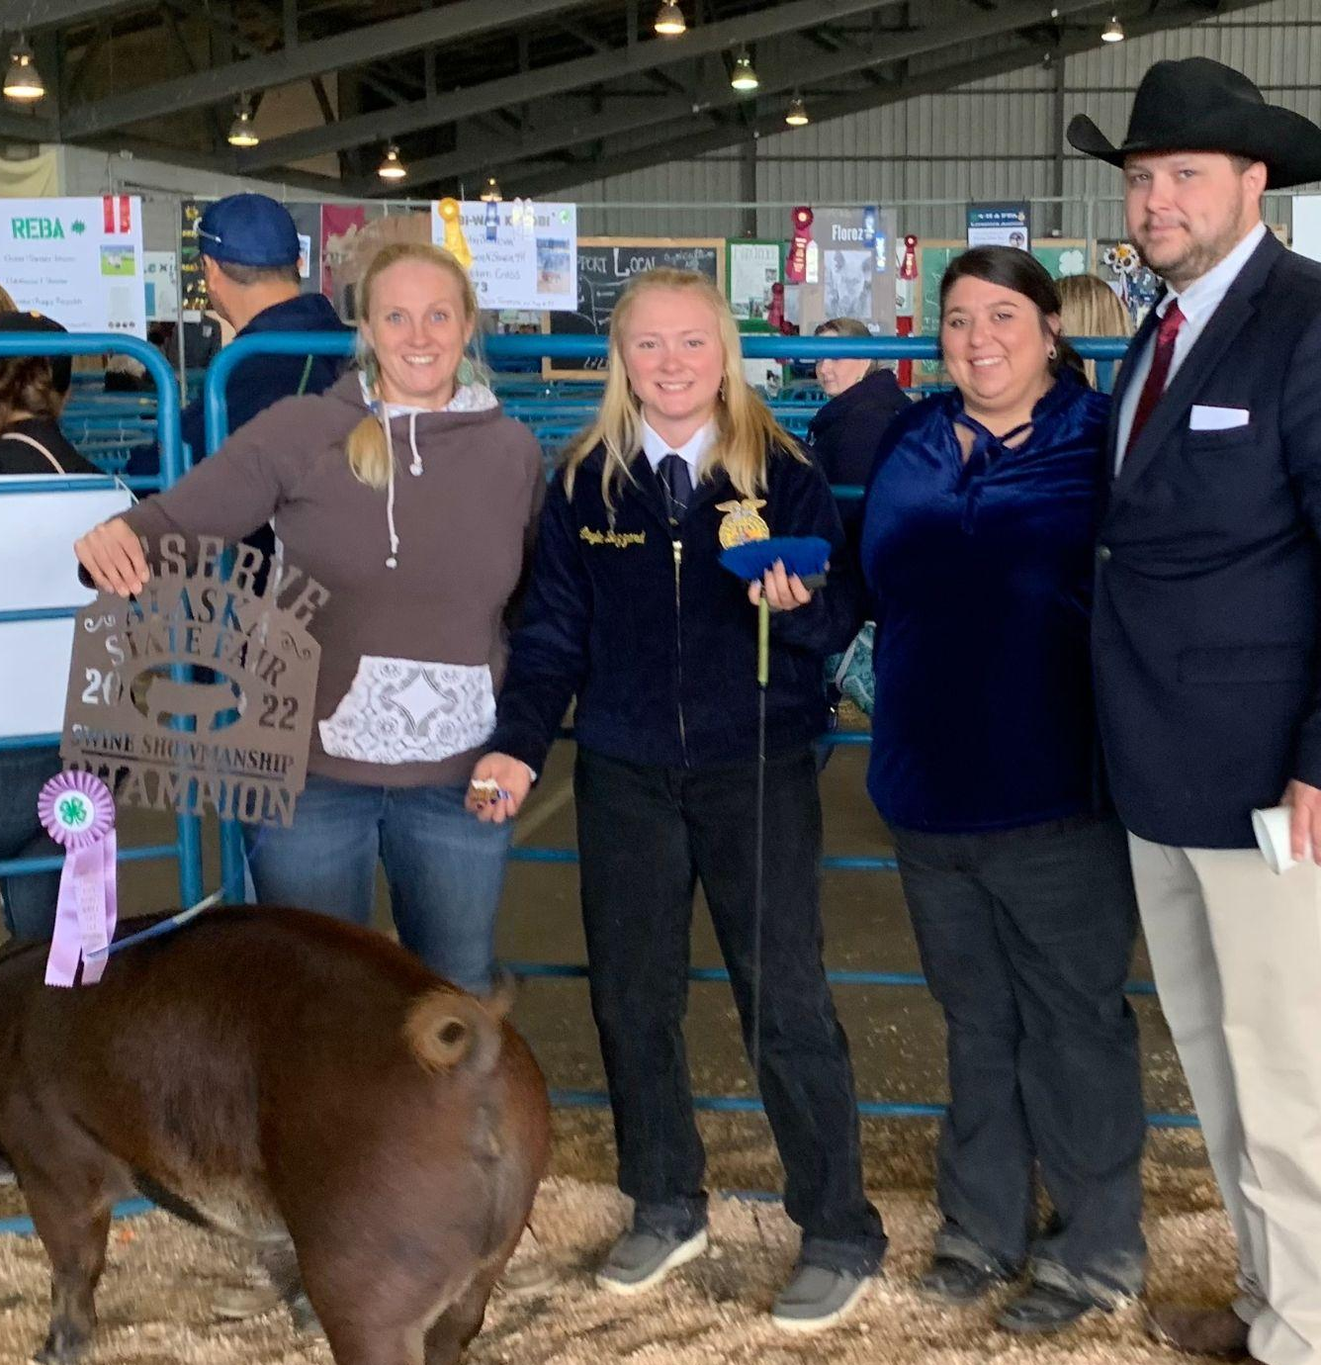
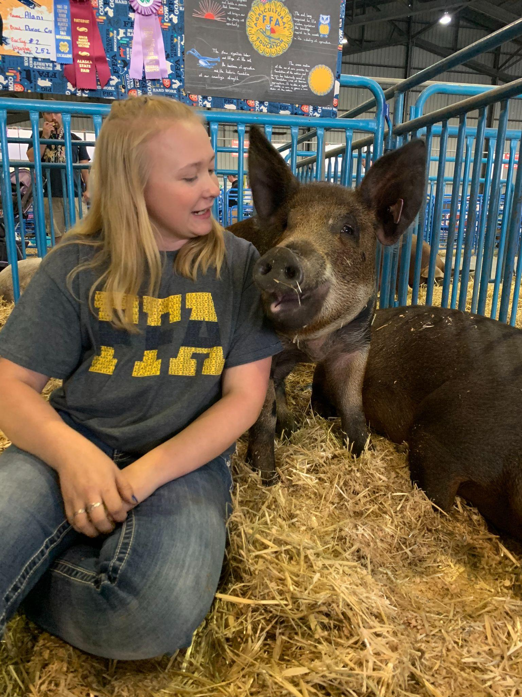
Star Farmer
Layla Buzzard
Star Awards
Notes:
The Star Farmer Award goes to Layla Buzzard from the Palmer FFA Chapter. Layla raises market swine and auctions them at the Palmer state fair. Layla's dedication is obvious, by the fact that she has earned over six thousand dollars in her SAE. We are happy to recognize all of your hard work with your market swine.

Slide 2
Star Placement
Aly Guernsey
Star Awards
Notes:
The Star Placement Award goes to Aly Guernsey from the Iron Mountain FFA Chapter. Aly’s SAE is in outdoor recreation where she does landscaping, house cleaning and wedding venue management. This award reflects your efforts at the Tern Lake Inn. We can’t wait to see what you accomplish next.

Slide 3
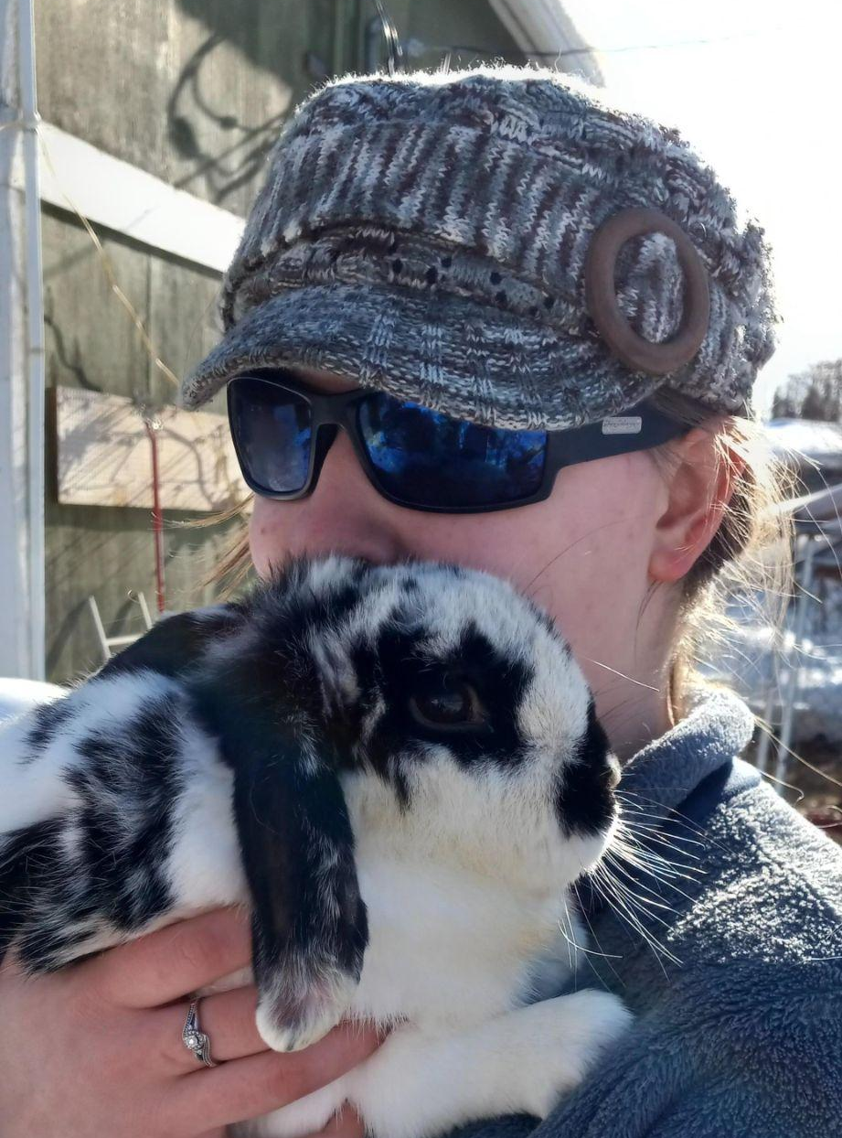
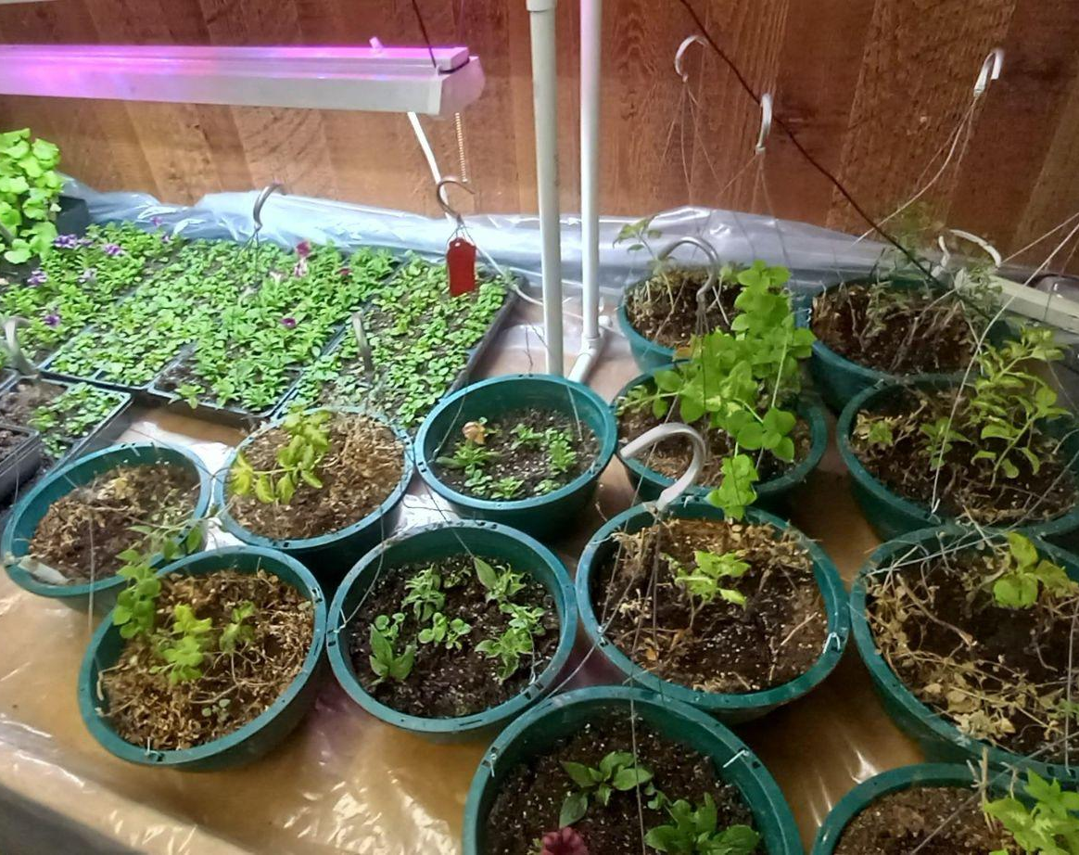
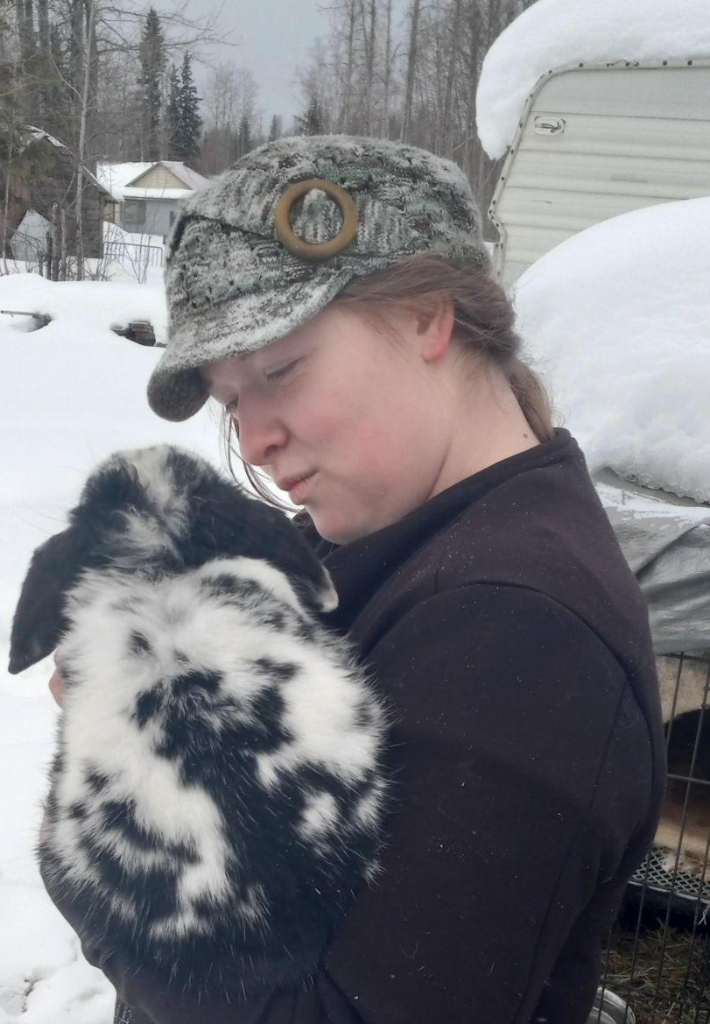
Star Agriscience
Lydia Henry
Star Awards
Notes:
The Star Agriscience Award goes to Lydia Henry from the Delta Junction FFA Chapter.
Your research with mint propagation, exploring animal processes and veterinary care are a great example of exploring your interests and broadening your horizons. Congratulations, we look forward to your future work.

